Slide 1

University Institute of Liberal Arts and Humanities
Course Name – Communication Skills
Course Code – 23PCH-105
NARRATION
DISCOVER . LEARN . EMPOWER

Slide 2
COURSE OBJECTIVES
The Course aims to:
1 | Augment students overall communication and interpersonal skills by making them realize the importance of good oral and written English Language in professional life.
2 | Enrich their reading capability with special emphasis on expanding vocabulary and grammatical formations.
3 | Build exceptional speaking, reading and writing skills by correcting grammatical errors and pronunciation through practice.
4 | Enhances soft skills by fostering self awareness, confidence and a positive attitude in students’ ability to communicate effectively in English.

Slide 3
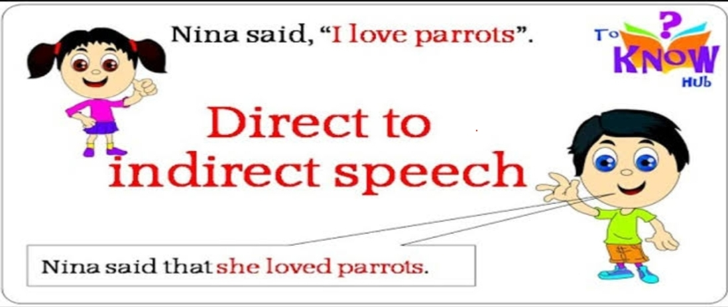
COURSE OUTCOMES
On completion, the students are expected to
CO Number | Title | Level
CO1 | Apply appropriate Listening, Speaking, Reading and Writing Skills (LSRW Skills) with correct non-verbal cues to attain expertise in soft skills. | Apply
CO2 | Apply correct contextual and comprehensible written text in the form of paragraph writing, short compositions business correspondence, using logical support and argument in a wide range of communication situations. | Apply
CO3 | Demonstrate linguistic competence while speaking and during presentations through accuracy in grammatical usage, vocabulary, pronunciation and intonation. | Apply
CO4 | Evaluate information as critical readers, speakers and writers applying ethics in communication and being sensitive in cross cultural communication. | Evaluate
CO5 | Create original, digital content for websites, blogs, vlogs and personal social media profiles etc. | Create
www.images.app.googl.com

Slide 4
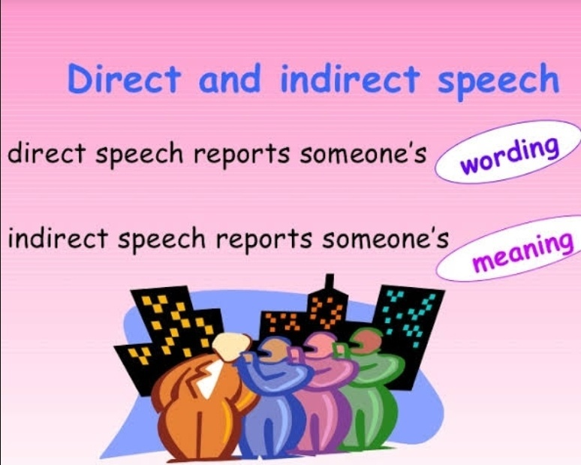
Narration
The art of reporting the words, messages, speeches, comments, and requests of a person or persons to others is called narration.
There are two main ways of reporting the words of a speaker:-
Direct Speech
Indirect Speech
https://www.google.com/imgres?

Slide 5
Narration
David said, “I am baking a chocolate cake for you.’’
David said that he was baking a chocolate cake for me.
If we consider these two sentences, we might notice that both of them convey the same message, but there is a difference if we look closely.
In the first sentence, I am conveying the activities of David in his (D) own words without changing it; it is called direct speech.
In the second sentence, I am using my own words to convey the activities of the speaker (D) to the audience. This we can say indirect speech or reported speech.

Slide 6
Direct Speech
Direct Speech: The speech which is under Quotation marks or inverted commas in writing is called Direct Speech or Reporting Speech. E.g.
Aryan said to Swati, "I will give my toys to you.“
Direct speech has two parts-
Reporting Verb
Reported Speech
Aryan said to Swati, "I will give my toys to you."
R.V R.S

Slide 7
Indirect Speech
Indirect Speech: The speech without quoting exact words is called Indirect or Reported Speech. We may report what the speaker said without quoting his exact words. E.g.
Aryan said to Swati, “I will give my toys to you.”
Aryan told Swati that he would give his toys to her.
He said, “I can do it.”
He said that he could do it.

Slide 8
Rules of Narration
1. If a reporting verb is in present or future e.g. ‘say, says or will say’, in direct speech it will remain same 'say, says or will say ‘ in indirect speech.
For example:
He says, “I will bring a camera for you.”
He says that he will bring a camera for me.
He will say, “I will bring a camera for you.”
He will say that he will bring a camera for me.
He said, “I will bring a camera for you.”
He said that he would bring a camera for me.

Slide 9
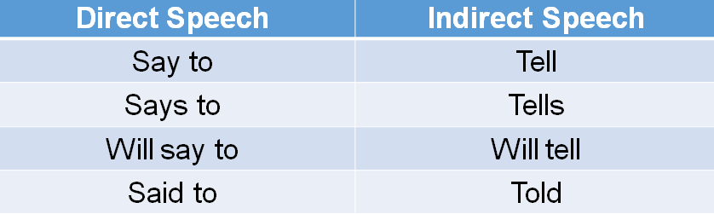
Rules of Narration
2. If 'to' is added with the Reporting Verb then in Indirect Speech it will be changed as per the rule below:

Slide 10
Poll Question-1
Q:- The Indian express says, "We shall issue a astrology section in our Thursday's paper".
1. The Indian express says that it will issue a astrology section in their Thursday's paper.
2. The Indian express says that they will issue a astrology section in their Thursday's paper.
3. The Indian express said that it will issue a astrology section in its Thursday's paper.
4. The Indian express says that it will issue a astrology section in its Thursday's paper.

Slide 11
Change in Pronouns
3. For changing direct to indirect speech, pronouns of reported speech are changed as per “S O N ” rule. E.g.
1 2 3
She said to me , “I like you very much.”
She told me that she liked me very much.
They said to me, “We have given our share to you.”
They told me that they had given their share to me.

Slide 12
Change in Modals
4. Modal verbs like shall, will, can and may change into should, would, could and might. Let’s follow some examples:
John said, “I will be there.”
John promised that he would be there.
Joseph said, “Shall I buy the car?”
Joseph asked if he should buy the car.
However, would, could, might, must, used to, ought to etc. remain unchanged.

Slide 13
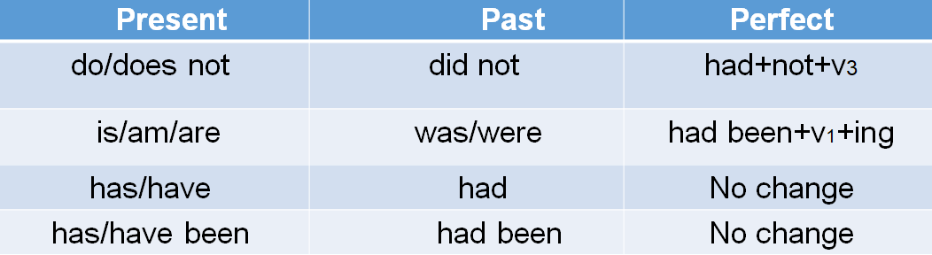
Change in Tenses
5. In narration (in indirect speech) tenses change from
Present Past Perfect.

Slide 14
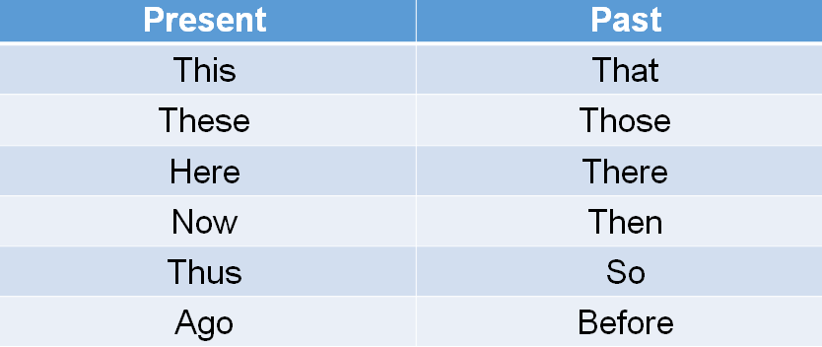
Change in Adverbs
6.The demonstrative (this, that etc.) and the adverb of time and place (here, there, today, now, etc.) observe the following changes.

Slide 15
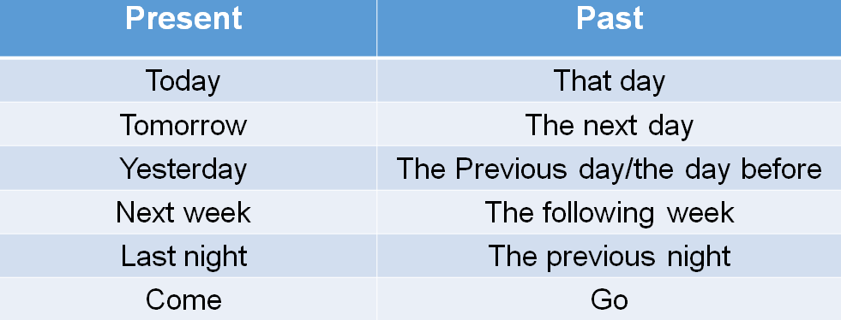
Change in Adverbs (Time)

Slide 16
Poll Question- 2
Q:- Ram said to Rahul, "You are a good player of cricket".
1. Ram told Rahul that he was a good player of cricket.
2. Ram told Rahul that he were a good player of cricket.
3. Ram told Rahul that he would a good player of cricket.
4. Ram told Rahul that he could be a good player of cricket.

Slide 17
Change in Interrogative Sentences
7.The interrogative sentences (question sentences) are changed into assertive form instead of question form.
The reporting verb is changed from “said” to “asked”.
To make indirect speech of such questions the word if and whether is used in indirect speech if it starts with a helping verb. E.g.
David said to me, “ Do you like Coffee?”
David asked me if I liked coffee.
He said to me, “Will you help me?”
He asked me if I would help him.

Slide 18
Change in Interrogative Sentences
8. No conjunction (If and whether) is used in Wh-type questions beginning with: what, why, when, where, who, whose, whom, which etc. E.g.
I said to her, “Where is my hammer?”
I asked her where his hammer was.
Aunt Jane said to Jack, “How much do you earn?”
Aunt Jane asked Jack how much he earned.

Slide 19
Change in Exclamatory Sentences
9. Exclamatory sentences in reported speech are changed into
statements.
The reporting verb “said” is changed into “exclaimed” followed by the conjunction “that”. E.g.
She said, “Alas! He has failed.”
She exclaimed with sorrow that he had failed.
“Hurrah! We have won,” they said.
They exclaimed with joy that they had won.

Slide 20
Change in Exclamatory Sentences
10. “What” and “How” in exclamatory sentences are placed by suitable adverbs such as “very”, “highly”, “extremely”, etc. E.g.
The boy said, “How amazing it is!”
The boy exclaimed that it was very amazing.
Sunita said, “What a beautiful scenery it is!” Sunita exclaimed that it was a very beautiful scenery.

Slide 21
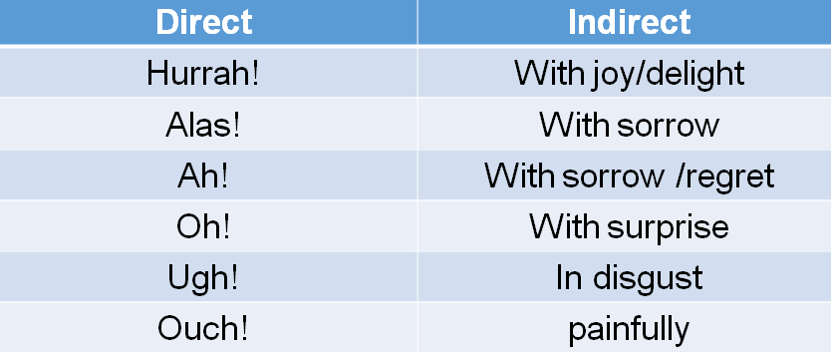
Change in Exclamatory Sentences
11. Some more words to be used in place of interjections and other constructions are as given below:

Slide 22
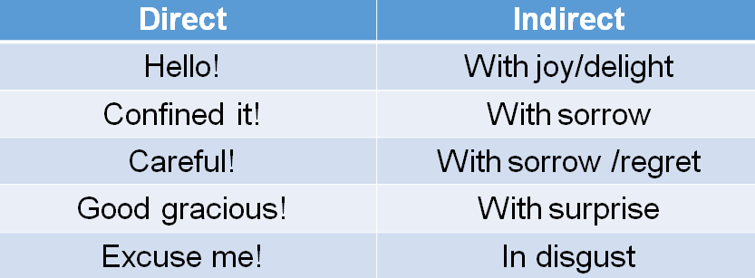
Change in Exclamatory Sentences
Some more examples are:-

Slide 23
Poll Question- 3
Q:- He said to us, "Are you going to market today?"
1. He asked us if we were going to market that day.
2. He asked us if you are going to market that day.
3. He asked us if we went to market that day.
4. He asked us if we had gone to market that day.

Slide 24
Practice Exercise
She said to me, “I had been waiting for him for two hours.”
They said, “We will be partying tonight.”
I said to her, “Why do you like me ?”
Rudra said to Kinjal, “Are you stupid ?”
Sunita said to her father, “Bring me a car, Please.”
John said to me , “Do you know where he is ?”
Jessy said , “Hurrah ! I have won the scholarship.”
The students said, “Alas ! We are fail again.”
The teacher says, “Rose smells sweet .”

Slide 25
Answers
She told me that she had been waiting for him for two hours.
They said that they would be partying that night.
I asked her why she liked me.
Rudra asked Kinjal if she was stupid.
Sunita requested her father to bring her a car.
John asked me if I knew where he was.
Jessy exclaimed with joy that she had won the scholarship.
The students exclaimed with sorrow that they were fail again.
The teacher says that Rose smells sweet.

Slide 26
APPLICATIONS
Teaching grammar to students is to think from creative angles.
It’s about having the ability to organize words, phrases, and sentences for maximum communication power.
If students don’t know grammar, they don’t know what’s possible with the English language.

Slide 27
Assessment Pattern
Students are assessed on the basis of the following parameters:
Hourly Tests - 2
Assignments
Surprise Test
Quiz
Student Engagement
End Semester Exam

Slide 28
REFERENCES
Reference Books:-
Murphy, R., Essential Grammar in Use, 5th Edition Cambridge
University Press (2018), UK
Hewing, Martin, English Grammar (Intermediate Level), Cambridge
University Press (2017), UK
Reference Websites:-
https://www.learngrammar.net/english-grammar/narration-reported- to-reporting
https://www.examweb.in/practice-set-for-direct-indirect-speech-narration-2417

Slide 29
THANK YOU
For queries
Email: communicationskills.uilah@gmail.com

